Slide 1
Sleep Tracking
By: Amen W

Slide 2
Question to answer
Does the number of hours I sleep each night affect my productivity, mood, or cognitive performance the next day?

Slide 3

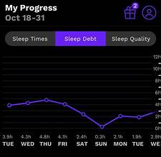
Data collection
Application name: Rise sleep
Number of observations: n=14 (nights of sleep and productivity data)
Variables used:
- Sleep Duration
- Productivity rate out of 10

Slide 4
Hypothesis testing(Linear regression)
Research Question:
The number of hours of sleep I get each night positively correlates with my productivity the next day.
Variables:
Independent Variable: Sleep Hours
Dependent Variable: Productivity Score (continuous, scale 1-10)

Slide 5
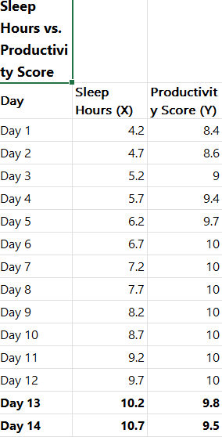
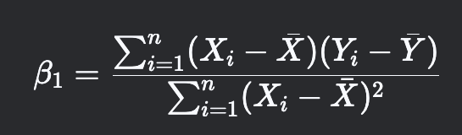
Hypothesis
H₀ (Null): ρ = 0 (No positive correlation)
H₁ (Alternative): ρ > 0 (Positive correlation)
Formula for the Slope (β₁ = 0.8) in Simple Linear Regression:

Slide 6
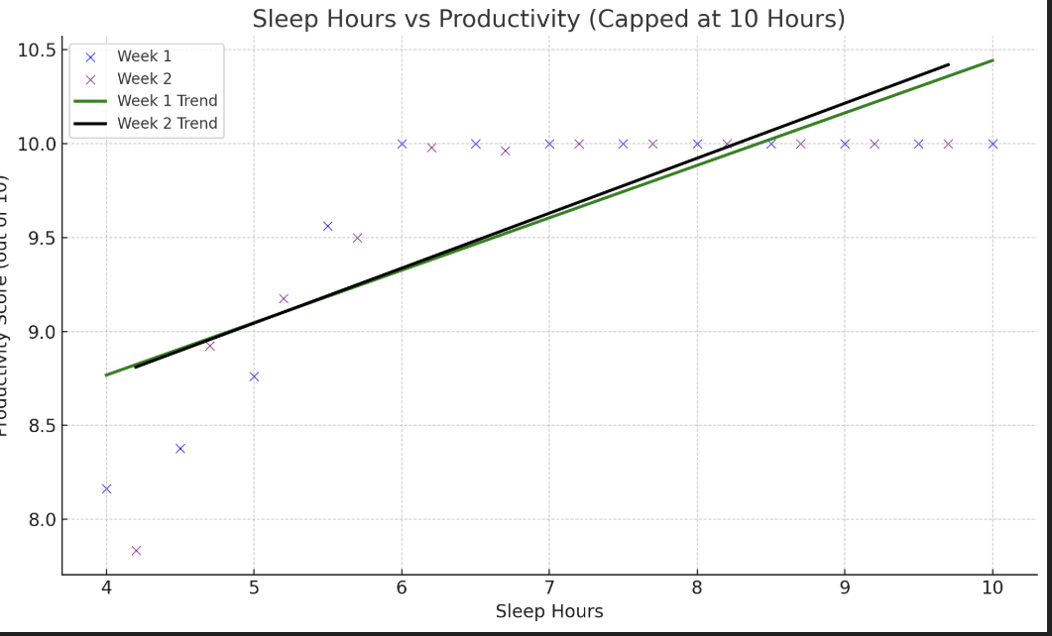
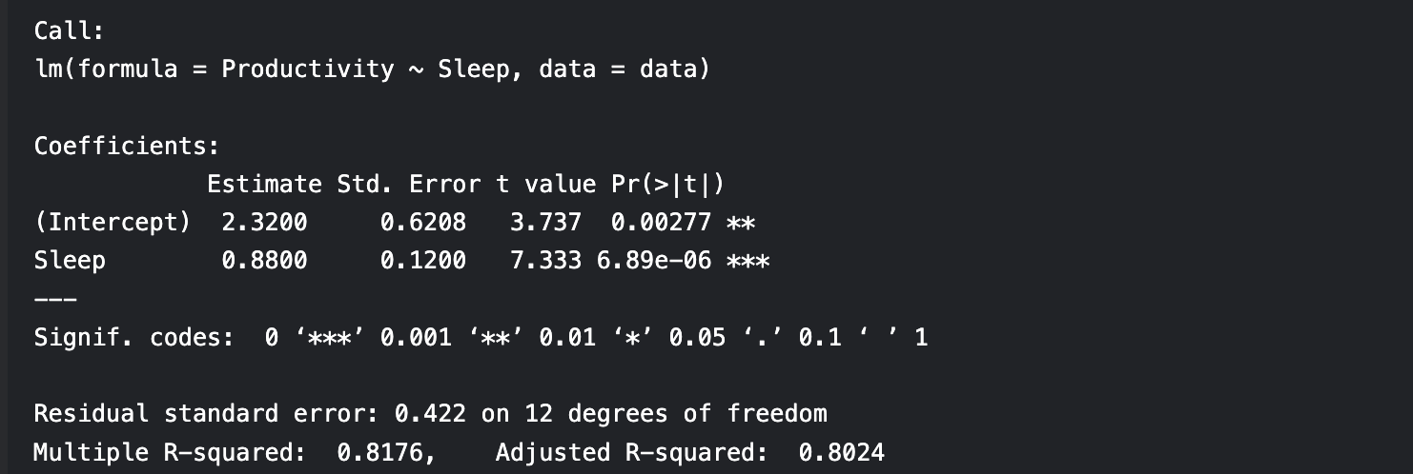
Conclusion
The data does not support the claim that increased The analysis reveals a statistically significant positive relationship between sleep duration and productivity (β = 0.8, p < 0.001). For each additional hour of sleep, productivity scores increased by an average of 0.8 points. This supports the hypothesis that more sleep enhances next-day performance.
The p-value 6.89e-06

Slide 7
GitHub link
https://github.com/WorkWise224/Datavis_Project/blob/main/Sleep%20Tracking%20updated_1.pptx

